Slide 1
IGGI Game Design Part II PTSP and Game AI Agents
Simon Lucas and Diego Perez

Slide 2
Contents
The Physical Travelling Salesman Problem
Rolling Horizon Evolutionary Algorithms
Monte Carlo Tree Search

Slide 3
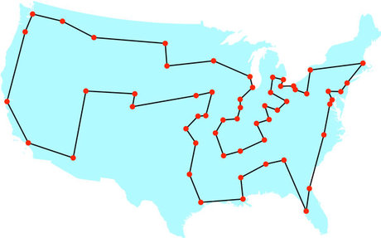
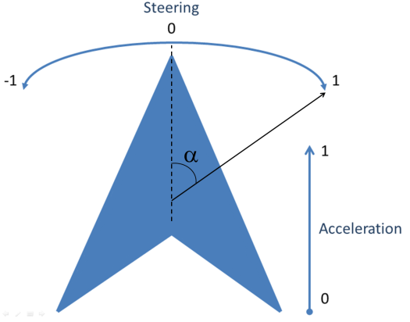
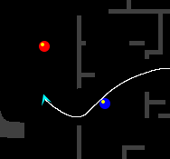


The Physical Travelling Salesman Problem
Travelling Salesman Problem:
Turn it into a real-time game!
Drive a ship.
In a maze.
With constraints:
10 waypoints to reach.
1000 steps to visit next waypoint.
40ms to decide an action.
1s initialization.

Slide 4
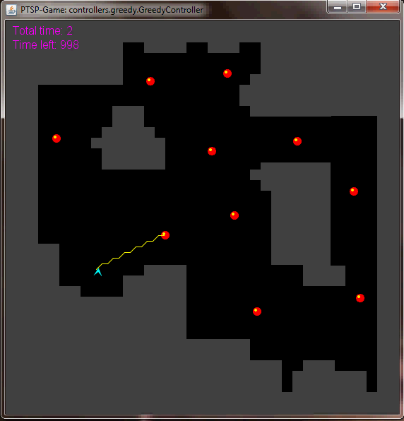
The Physical Travelling Salesman Problem
Features some aspects of modern video games:
Pathfinding.
Real-time game.
Competitions.
www.ptsp-game.net (expired)
WCCI/CIG 2012, CIG 2013
Winner: MCTS.

Slide 5
The PTSP Framework - code
The code provided to create controllers is divided into Java packages. These include:
controller: Controllers must be in a sub-package of this package:
Sample controllers: random.RandomController, greedy.GreedyController, lineofsight.LineOfSight and WoxController.WoxController are.
This package also contains controllers you’ll be working with today
simpleGA.GAController
mcts.MCTSController
framework. This package contains all the code for the game.
core: Core code of the game.
graph: Code for path finding.
utils: Includes useful classes.
classes ExecSync, ExecReplay, ExecFromData: Executes a controller in different execution modes.

Slide 6
The PTSP Framework - execution
framework.ExecSync.java: To execute one or several maps, with and without visuals:
Mode 1: executes several games, N times each, getting a summary of results at the end.
Mode 2: runs once in a map.
Mode 3: human-player mode.

Slide 7
The PTSP Framework – controllers
In order to create a controller for this game, the participant must write a Java class that extends framework.core.Controller. Two methods need to be implemented in this class:
A public constructor that receives a game copy (class Game).
A function called getAction(), that returns an int and receives a game copy (Game class, again) and a long variable that indicates where the controller is due to respond with an action. This function will be called every execution cycle to retrieve an action from the controller.

Slide 8
The PTSP Framework – actions
framework.core.Controller.ACTION_NO_FRONT:
No rotation and no acceleration.
This is also the action applied if no response is received within the time given.
framework.core.Controller.ACTION_NO_LEFT:
Left rotation but no acceleration.
framework.core.Controller.ACTION_NO_RIGHT:
Right rotation but no acceleration.
framework.core.Controller.ACTION_THR_FRONT:
No rotation, only forward acceleration.
framework.core.Controller.ACTION_THR_LEFT:
Left rotation and acceleration.
framework.core.Controller.ACTION_THR_RIGHT:
Right rotation and acceleration.

Slide 9
The PTSP Framework – game flow
The main class creates the game and the controller, using the appropriate constructor of this class, expecting a response in a specific time.
The main class executes the game loop, which calls the controller's method getAction() supplying a copy of the game and the time due to receive the action:
Reply in less than PTSPConstants.ACTION_TIME_MS (40ms), the action indicated is executed.
Reply after PTSPConstants.ACTION_TIME_MS and the default action (0: No acceleration and no rotation) is applied instead.

Slide 10
Requirements
A few important functions are key in the implementation of controllers with forward model:
function State Advance (State s₁, Action a₁): Takes one state s1 and an action a1, and returns the state reached after applying a₁ from s₁.
function State Copy (State s): Returns a copy of a given state.
function double Evaluate (State s): Assigns and returns a reward (r_{T}).

Slide 11
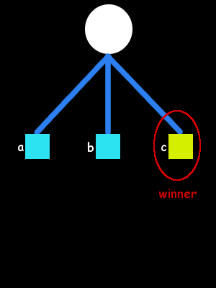
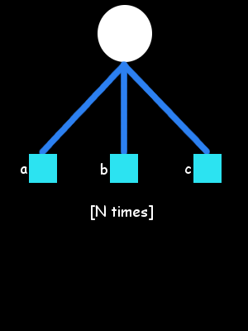
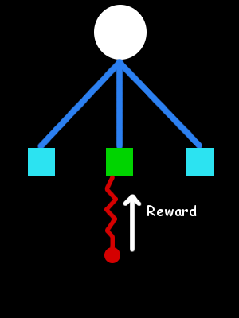
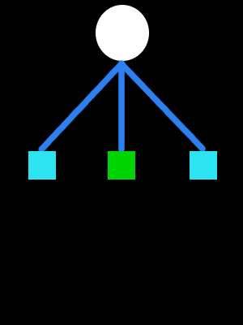
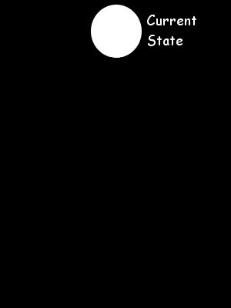
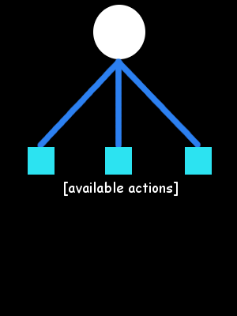
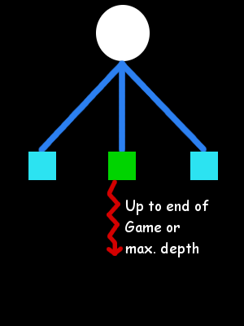
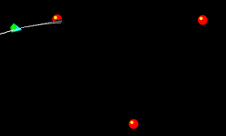
Short-term and Long-term planning
Monte Carlo (MC)
MC methods for long term planning:
Unsuitable for Long-term planning.
Terminal states not reached.

Slide 12
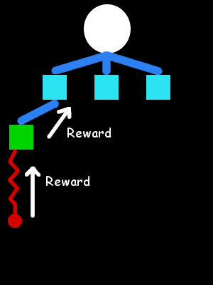
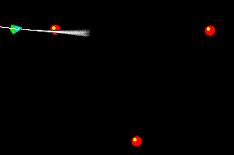
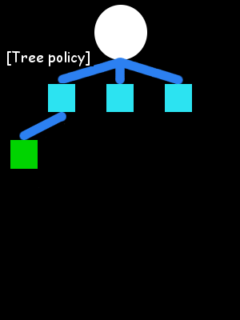
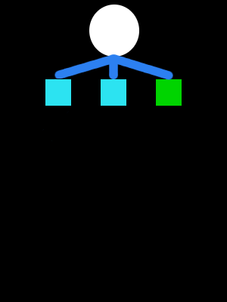
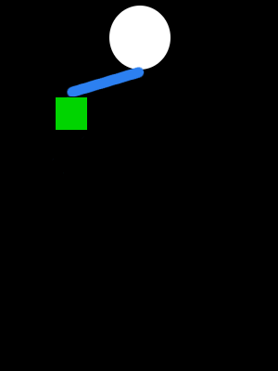
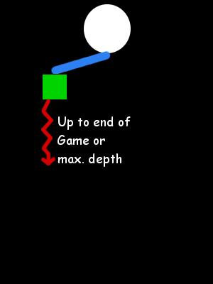
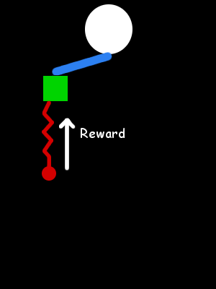
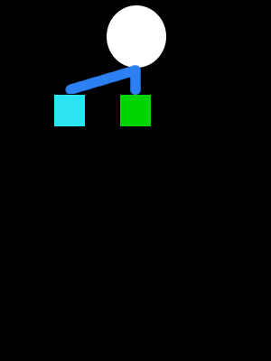
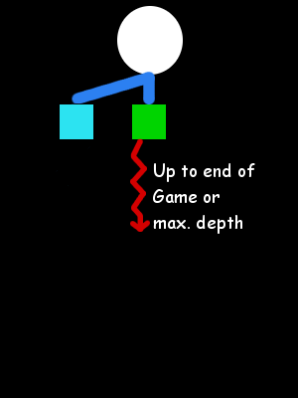

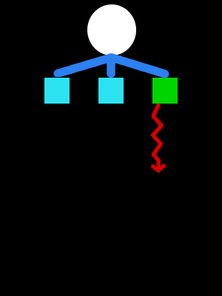
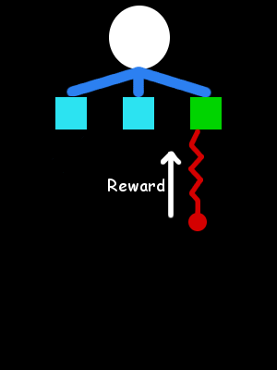
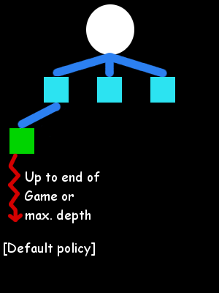
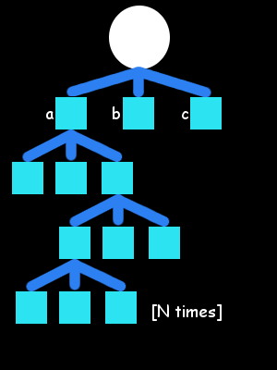
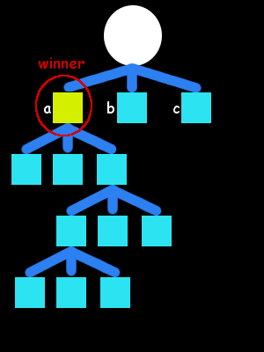
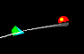
Short-term and Long-term planning
Monte Carlo Tree Search (MCTS)
Monte Carlo Tree Search:
Builds an asymmetric tree.
Further look ahead.
Even this is usually insufficient: time and search space size…

Slide 13
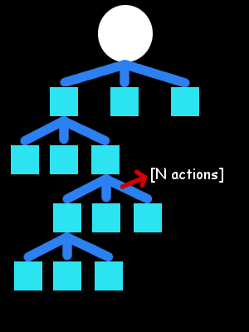
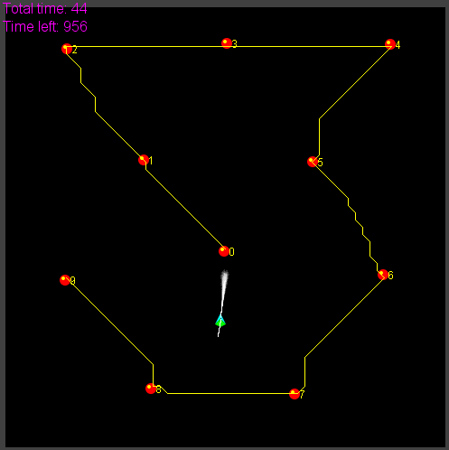
Short-term and Long-term planning
Alternative 1:
Macro-actions.
Alternative 2:
Higher-level planner.

Slide 14
Including the route planner
Question: Is any order better than none?
Solve TSP:
Branch and Bound algorithm.
Cost between waypoints: Euclidean distance.
Cost between waypoints: A* path cost.
Can we improve it further?
No.

Slide 15
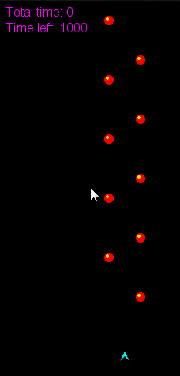
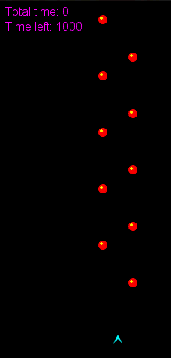
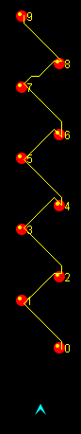
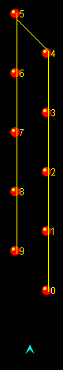
Improving the route planner

Slide 16
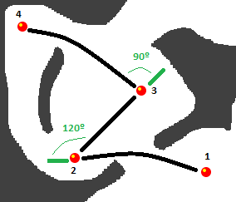
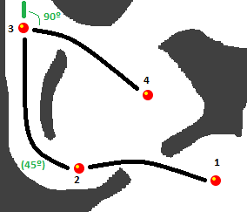
Improving the route planner
Interdependency between long- and short-term planning
Use the proper MCTS driver is prohibitively costly
Add turn angles to the cost of the paths

Slide 17
Long-term vs Short-term
Long-term vs. Short-term planning.
Tree-search limitations and long-term planning in real-time games.
PTSP
Optimal distance-based TSP solution
≠
Optimal physics-based TSP solution.
Game Level Design
Challenging maps for PTSP.
Automated Map Generation for the Physical Travelling Salesman Problem. Diego Perez, Julian Togelius, Spyridon Samothrakis, Philipp Rolhfshagen and Simon M. Lucas, in IEEE Transactions on Evolutionary Computation, 18:5, pp. 708–720, 2013.

Slide 18
Solving the PTSP – TSP Solvers

Slide 19
Solving the PTSP – Macro-actions
Single action oriented solutions:
6 actions, 10 waypoints, 40ms to choose move.
1000-2000 actions per game.
Search space ~ 6¹⁰⁰⁰ - 6²⁰⁰⁰
Limiting look-ahead to 2 waypoints:
Assuming 100-200 actions per waypoint.
Search space ~ 6¹⁰⁰ - 6²⁰⁰
Introducing macro-actions:
Repetitions of single actions in L time steps.
Search space ~ 6¹⁰ – 6²⁰ (L=10).
Time to decide a move increased: L*40ms

Slide 20
Solving the PTSP – Score function
Heuristic to guide search algorithm when choosing next moves to make.
Reward/Fitness for mid-game situations.
Components:
Distance to next waypoints in route.
State (visited/unvisited) of next waypoints.
Time spent since beginning of the game.
Collision penalization.

Slide 21
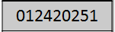
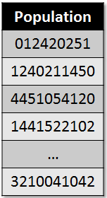
Rolling Horizon Evolutionary Algorithms
Individual as a sequence of N macro-actions.
Initialized at random
Evolve population during L (macro-action length) game steps.
Fitness: score function.
Tournament selection.
Uniform crossover.
Mutation (smooth).
Reset population after L game steps.

Slide 22
Morning exercise/lab in groups
Download the PTSP code with samples (the-ptsp-competition.zip)
Have a look at the code:
Execution of the game (framework.ExecSync)
Check the RHEA Controller (controllers.simpleGA.GAController)
Examine how order of waypoints are calculated (controllers.heuristics.TSPGraphPhyiscsEst)
Tune:
The parameters of the RHEA Controller (pop size, individual length, tournament size, mutation, etc. – GA.java)
The score/value function (GameEvaluator.score)
Try to beat initial RHEA performance in all 10 maps (and others’controllers?).

Slide 23
Simulation-based Search
Forward search algorithms select the next action to take by looking ahead the states found after applying certain available actions.
They need a model of the game to simulate these actions.
Given a current state S_{t} and an action A_{t} applied from S_{t}, the forward model will provide the next state s_{t+1}
S_{t,} A_{t} S_{t+1}
Forward
Model

Slide 24
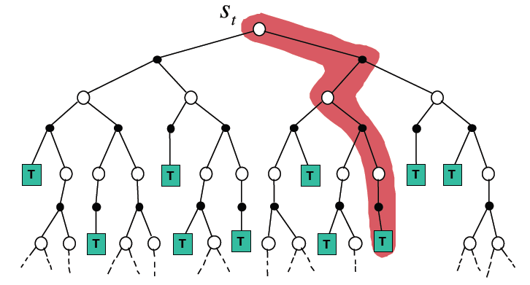
Simulation-based Search
Simulate episodes of experience from the current state using the model:
Until reaching a terminal state (game end) or a predefined depth (i.e. the end of a chess game may be many plies ahead!)

Slide 25
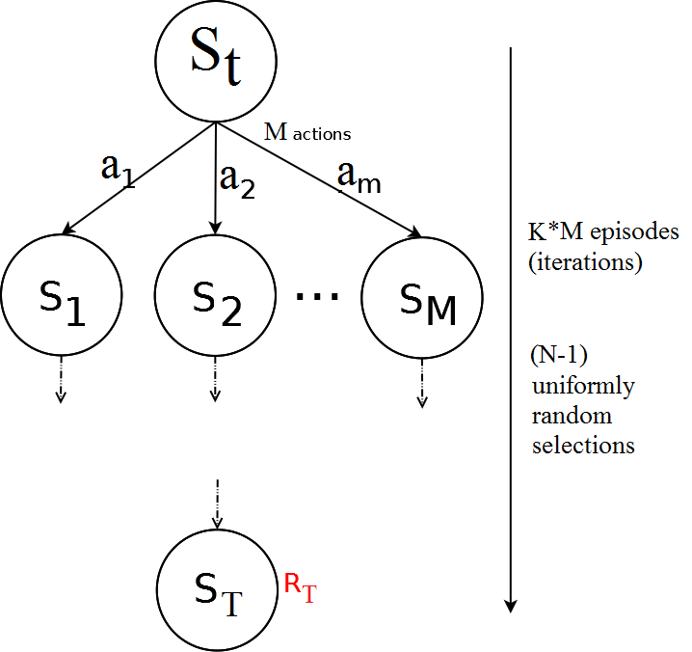
Flat Monte Carlo
Given a model M and a simulation policy π, that picks actions uniformly at random:
Iteratively, apply K episodes (iterations) from each one of the M actions.
Select the action at each step uniformly at random, random until reaching terminal state or pre-defined depth.
Compute the average reward for each action.
Pick the action that leads to the highest average reward after K*M episodes.

Slide 26
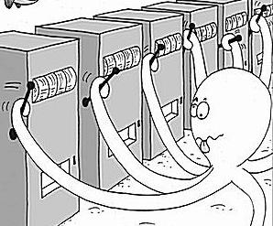
Regret and Bounds
Is picking actions at random the best strategy?
Should we give to all actions the same amount of trials?
We are treating all actions as equal, although ones might be clearly better than others. But then, what is the best policy?
Balance between exploration and exploitation.
Exploitation: Make the best decision based on current information.
Exploration: Gather more information about the environment. This is, not choosing the best action found so far.
The objective is gather enough information to make the best overall decision.
N-armed Bandit Problem

Slide 27
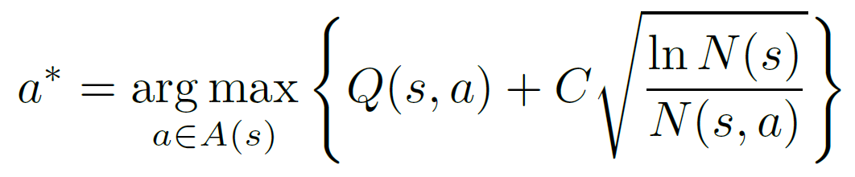
UCB1
UCB1 (typically found in the literature in this form):
Q(s,a): Q-value of action a from state s (average of rewards after taking action a from state s).
N(s): Times the state s has been visited.
N(s,a): Times the action a has been picked from state s.
C: Balances between exploitation (Q term) and exploration (square root).
Value of C is application dependent.
Example: single player games with rewards in [0,1]: C = SQRT(2)

Slide 28
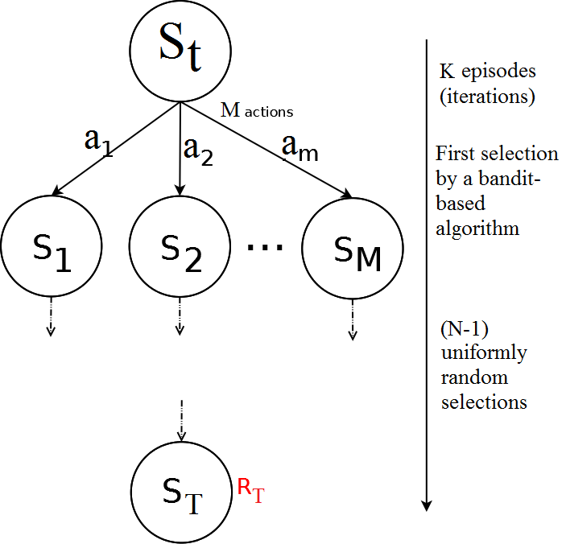
Flat UCB
Given a model M and a bandit-based simulation policy π, that picks actions uniformly at random:
Note that the policy π improves at each episode!
Iteratively, apply K episodes (iterations).
Select the first action from S_{t} with a bandit-based policy (UCB1, or any other UCB).
Pick actions uniformly at random until reaching terminal state or pre-defined depth.
Compute the average reward for each action.
Pick the action that leads to the highest average reward after K episodes.

Slide 29
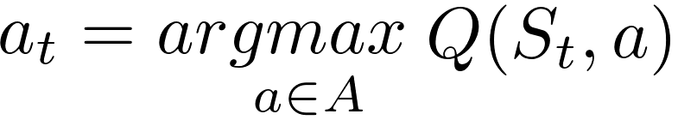
Building a Search Tree
Given a model M and the current simulation policy π:
For each action a ∈ A:
Simulate K episodes from current state S_{t}
Each episode is run until reaching a terminal state S_{T}, with an associated reward R_{T} (or a number of moves is reached).
Compute Mean/Expected Return for each action (Monte Carlo evaluation)
Build a search tree containing visited states and actions
Recommendation Policy:
Select action to apply with highest Expected Return
(greedy recommendation policy)

Slide 30
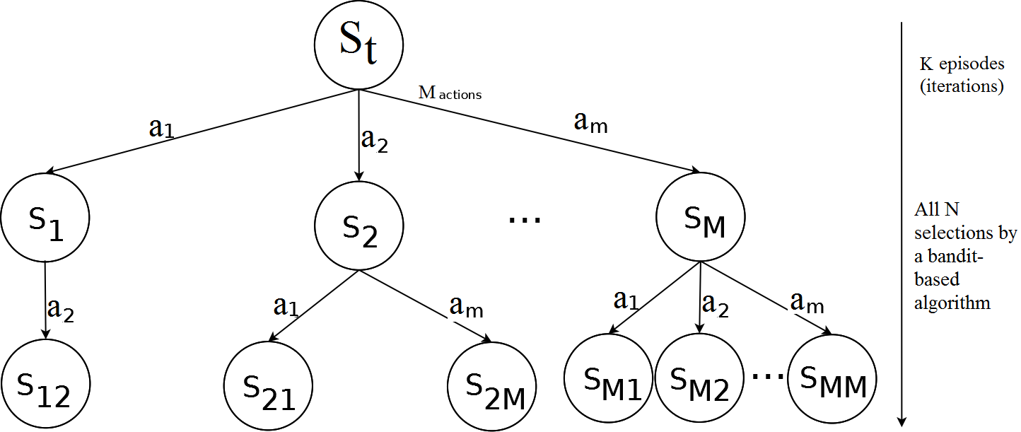
Simulation-Based Search: Building a tree
Applying and UCB policy, adding a node (state) at each iteration, the tree grows asymmetrically, towards the most promising parts of the search space.
This is, however, limited by how far can we look ahead into the future (less than with random roll-outs outside the tree – the tree would be too big!).

Slide 31
Monte Carlo Tree Search
Adding Monte Carlo simulations (or roll-outs) after adding a new node to the tree: Monte Carlo Tree Search.
2 different policies are used on each episode:
Tree Policy: Improves on each iteration. It is used while the simulation is in the tree. Some naming conventions:
UCT Algorithm: MCTS with any UCB tree selection policy.
Plain UCT Algorithm: MCTS with UCB1 as tree selection policy.
Default Policy: It is fixed through all iterations. It is used while the simulation is outside the tree. Picks actions randomly.
On each iteration:
Q(s,a) on each node of the tree is updated.
So do N(s) and N(s,a)
Tree policy π is based on Q (i.e., UCB, UCB1): improves on each iteration!
Converges to optimal search tree

Slide 32
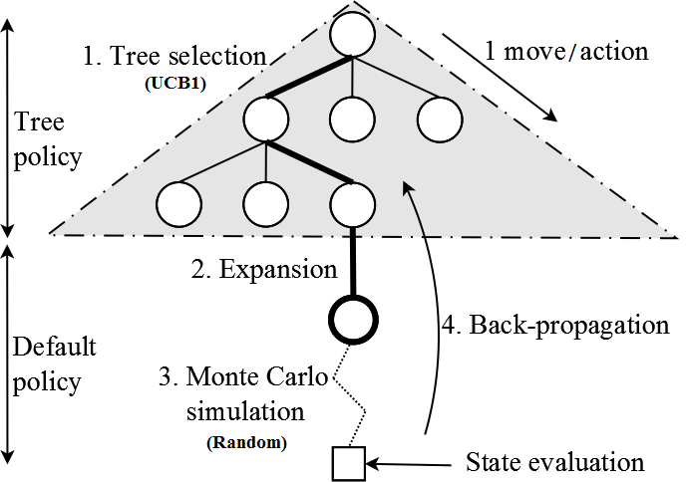
Monte Carlo Tree Search
4 Steps: Repeated iteratively during K episodes.
1. Tree selection: Following the tree policy (i.e. UCB1), navigate the tree until reaching a node with at least one child state not in the tree (this is, not all actions have been picked from that state in the tree).
2. Expansion: Add a new node in the tree, as a child of the node reached in the tree selection step.

Slide 33
Monte Carlo Tree Search
4 Steps: Repeated iteratively during K episodes.
3. Monte Carlo simulation: Following the default policy (picking actions uniformly at random), advance the state until a terminal state (game end) or a pre-defined maximum number of steps. The state at the end of the simulation is evaluated (this is, retrieve R_{T}).
4. Back-propagation: Update the values of Q(s,a), N(s) and N(s,a) of the nodes visited in the tree during steps 1 and 2.

Slide 34
Advantages of Monte Carlo Tree Search
Highly selective best-first search.
Evaluates states dynamically (not like Dynamic Programming).
Uses samples to break the curse of dimensionality.
Works in black-box models (only needs samples).
It is computationally efficient (good for real-time games).
It is anytime: it can be stopped at any value of K and return an action from the root at any moment in time.
It is parallelizable: run multiple iterations in parallel.

Slide 35
MCTS: Implementation details
Depending on your implementation, you may end up using one more than another:
Closed-loop approach: the nodes in the tree store the state reached at that position in the tree.
During the Tree Selection step, no need to call Advance. We already have the next state in the child node.
During the Expansion phase, call Copy to store the returned state on the new node.
Advance is used during the Monte Carlo Simulation.
Open loop approach: the nodes in the tree do not store the states.
At the beginning of each iteration, Copy the current state, and keep the copy until reaching the end of the Monte Carlo simulation step.
For all Tree Selection, Expansion and Monte Carlo simulation, use Advance to modify the copy of the state until the end of the simulation.
The nodes of the tree only keep the statistics (Q(s,a), N(s), N(s,a)), not the states.

Slide 36
Open versus Closed Loop Search
What is better? Depends…
Efficiency and cost of each operation.
Stochasticity: when Advance() from (s₁,a₁) does not always returns exactly the same state (i.e. imagine an element in the game that moves randomly, not under the control of the player).
In closed loop, once the state is stored, it remains unchanged.
The advance() call might have been lucky… or unlucky.
In any case, the state obtained during the expansion phase is only one of the possible states reachable at that position in the tree.
In open loop, only statistics on the nodes.
Advance is used at each step during the tree policy.
The statistics represent better the truly distribution of the states on that node.
If the game is deterministic, open loop ≡ closed loop.
If the game is stochastic, open loop is more accurate.

Slide 37
After exercise/lab in groups
Same PTSP code.
Have a look at the MCTS Controller (controllers.mcts.MCTSController).
Tune:
The parameters of the MCTS Controller (depth, macro-action length, C, etc. – MCTS.java)
The score/value function (GameEvaluator.score)
Try to beat initial MCTS performance in all 10 maps, and other groups’ controllers.
How does it compare with RHEA?

